Slide 1
GradStar: Cost of Attendance (COA) Adjustments
Notes:
In this video we will learn how to request a cost of attendance adjustment in grad star .

Slide 2
By the end of the course…
Understand the purpose of a COA adjustment.
Departmental responsibilities.
How to request a COA adjustment in in GradStar for the following award types:
Training Grant Dependent Care
Training Grant Travel
Dept. Travel
Research/Internship
Emergency Payment
Notes:
By the end of this course, you will understand the purpose of a cost of attendance adjustment, be aware of departmental responsibilities to maintain documentation, and know how to request a COA adjustment in GradStar for emergency, research/ internship, dependent care and travel award types.

Slide 3
Let’s get started…
COA = Cost of Attendance
ack
Notes:
Let’s get started! For the duration of this course, the abbreviation COA will be used often be used to reference the words Cost of Attendance.

Slide 4
What is the purpose of a COA adjustment?
To add educational expenses not originally included in the financial aid COA to the COA.
Ensure that payments made to aid recipients are recorded as aid for federal compliance.
Increase aid eligibility which allows financial aid recipients to receive payments specifically designated for travel, research, dependent care, or emergencies.
View COA components on Office of Scholarships & Student Aid (OSSA) website.
Notes:
The purpose of the cost of attendance adjustment is to add educational expenses not originally included in the financial aid COA to the COA.
Ensure that student payments are recording properly as aid to adhere to financial aid compliance guidelines.
Increase aid eligibility which allows financial aid recipients to receive payments specifically designated for travel, research/internships, dependent care or emergencies.
A complete list of all components for the financial aid COA is listed on the Office of Scholarships and Student Aid website

Slide 5
When it is appropriate to request a COA adjustment?
When providing payment for one of the following award types:
Dept. Travel (VSG)
Dept. Training Grant Travel (TGT)
Dept. Training Grant Dept. Care (TGD)
Dept. Research-Internship (RIG)
Dept. Emergency Payment (EMR)
AND
Student is receiving aid from the Office of Scholarships & Student Aid (OSSA)
Notes:
Understanding when it's appropriate to make a COA adjustment request is an important part of the process. Only award types for student travel, dependent care, research/ internship expenses or emergency payments are available for a COA adjustment request in GradStar.
In addition, only students who have applied for aid through the office of scholarships and student aid will benefit from a COA adjustment.

Slide 6
When it is appropriate to request a COA adjustment?
How do I determine who is a financial aid recipient?
Student can self- disclose.
Department can inquire about aid status by including supplemental questions to funding applications.
Ex. Have you applied for aid with OSSA? Are you receiving aid from OSSA?
Contact OSSA for confirmation.
https://studentaid.unc.edu/conact
Notes:
Determining which students are financial aid recipients can be a bit tricky.
Some students may choose to self disclose their aid status to you. Department's can also choose to add supplemental questions to their funding applications such as “Have you applied for financial aid with the Office of Scholarships and Student Aid? Or, “Are you receiving financial aid from the Office of Scholarships and Student Aid”? Adding these general questions to funding applications maybe a quick way to determine which students are aid recipients.
When in doubt the Office of Scholarships and Student Aid (OSSA) is available to assist and confirm aid status.

Slide 7
Let’s look at some examples…
Click on each example. Review all examples before clicking “Next”.
Example 1
Example 2
Example 3
Back
Next
Notes:
Let's look at some examples of scenarios that warrant a COA adjustment request in grad star.

Slide 8
Let’s look at some examples…
Example 1
Emory is a PhD student and training grant recipient. The training grant has an allocation specifically designated for student professional development. Emory’s department is proving payment in GradStar using the TGT award type so that Emory can travel to a conference for professional development and networking.
Emory applied for financial with the OSSA and disclosed that to the department. The department will complete a COA adjustment request so Emory’s aid eligibility can be increased which will allow him to receive the full travel payment to attend the conference.
Return to Examples
Notes:
Emory is a PhD student and training grant recipient. The training grant has an allocation specifically for professional development. Emory's department is providing payment in grad star using the TGT award type so that Emory can travel to a conference for professional development and networking.
Emory applied for financial aid with the Office of Scholarships and Student Aid and disclosed that to the department. The department will complete a COA adjustment request so Emory’s aid eligibility can be increased which will allow him to receive the full travel payment to attend the conference.

Slide 9
Let’s look at some examples…
Example 2
Parker’s department is providing research grants to help Masters students with their thesis. Parker will use the research grant for study subject payments. Parker’s department will use the RIG award type in GradStar to provide Parker the research grant payment up front.
Parker indicated on the departmental funding application that she did apply for financial aid. Parker’s department chooses to request a COA adjustment so that Parker can receive the funds needed to complete her research.
Next
Return to Examples
Next
Notes:
Parkers department is providing research grants to help master students with their thesis Parker will use the research grant for study subject payments parkers department will provide payment in GradStar using the RIG award type.
Parker indicated on the departmental funding application that she did apply for financial aid. Parker's department chooses to request a COA adjustment so that Parker can receive the funds needed to complete her research.

Slide 10
Let’s look at some examples…
Example 3
Bao’s roommate has become abusive which is putting a strain on living conditions. The abusive situation is affecting Bao’s ability to function academically and socially. Bao confides with Student Affairs about the situation and is granted emergency funds to relocate. Student Affairs is providing payment to Bao using the EMR award type.
Student Affairs contacts the OSSA to inquire about aid status. OSSA confirms the Bao applied for financial aid. Student Affairs completes a COA adjustment request so that Bao’s payment is recorded as aid and his aid eligibility is adjusted so that he receives the emergency funds needed to relocate.
Return to Examples
Notes:
Bao’s roommate has become abusive which is putting a strain on living conditions . The abusive situation is affecting Bao’s ability to function academically and socially. Bao confides with Student Affairs about the situation and is granted emergency funds.
Student affairs contacts the Office of Scholarships and Student Aid (OSSA) to inquire about Bao’s aid status. The OSSA confirms that Bao has applied for financial aid. Student affairs completes a COA adjustment request so that Bao’s payment is recorded as aid and his aid eligibility is adjusted so that he receives the emergency funds needed to relocate.

Slide 11
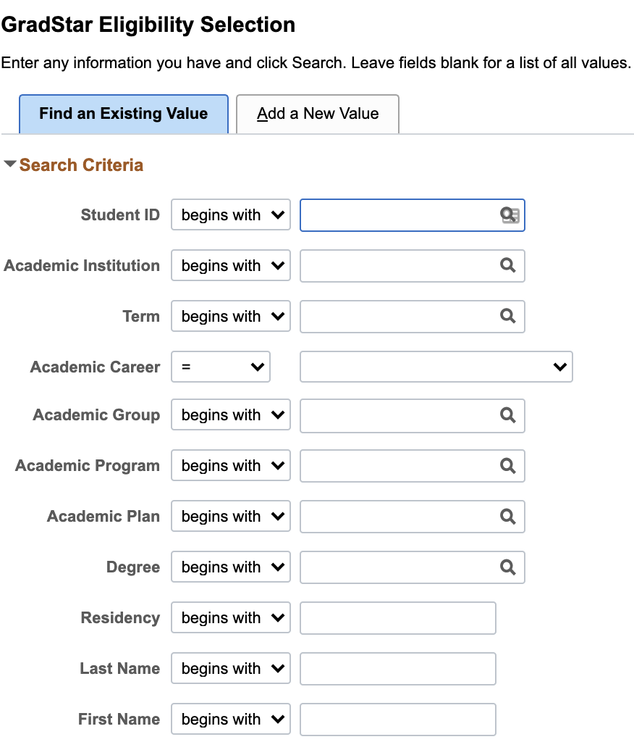
Requesting a COA Adjustment
Mark Student Eligible
Enter 9 Digit Student ID
Academic Institution
UNCCH
Term
Academic Career
Back
Next
Notes:
The first step to requesting a COA adjustment in grad star is to mark the student eligible on the grad star eligibility selection page. Enter the students 9- digit ID number, academic institution which will always be UNCCH , the term , and the academic year and click search.
See GradStar Step-by Step Guide at https://gradschool.unc.edu/policies/faculty-staff/gradstar/

Slide 12
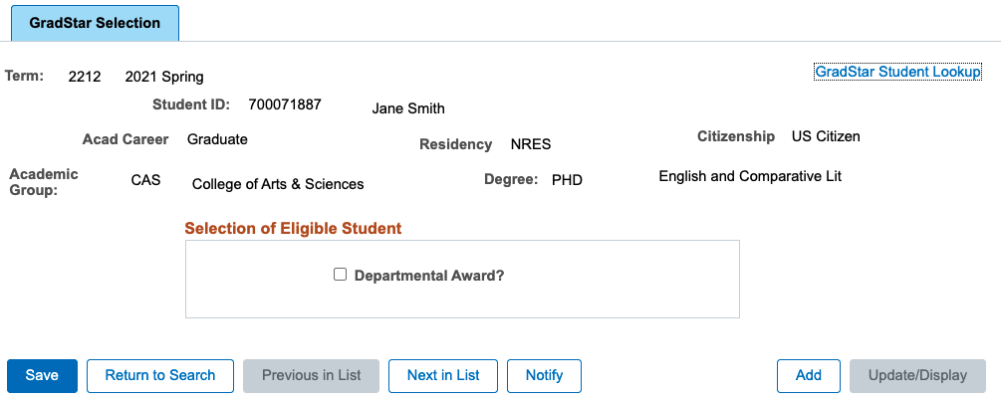
Requesting a COA Adjustment
Mark Student Eligible
Ensure Degree Program Listed
Click Check box
Save
Click to mark student eligible
Notes:
When you arrive on the eligibility selection page make sure there is a degree and program listed. Next, click the box by departmental award, and save the page.
See GradStar Step-by Step Guide at https://gradschool.unc.edu/policies/faculty-staff/gradstar/

Slide 13
Request a COA Adjustment
Use the GradStar Maintenance Page to enter award
Enter Award Type
Chartfield data
Award Amount
Click on Adjust COA
NOTE: Adjustments only available for award types:
EMR , VSG , TGT , TGD, RIG, and EMR
Notes:
Navigate to the grad star maintenance page and enter the award type , chartfield data and award amount. After the award amount is entered click on adjust COA.

Slide 14
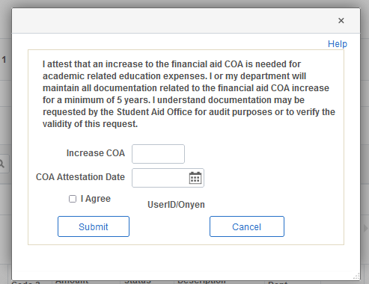
Request a COA Adjustment
COA Attestation
Departmental Responsibility
Enter adjustment amount
Provide attestation completion date
Click the “agree” box and submit
Documentation may include:
- receipts for travel purchases
- receipts for emergency expenses
- documents for research/internship expenses.
Notes:
When requesting a COA adjustment you will need to attest that the COA increase is needed for academic related expenses.
In addition, the department will need to maintain documentation for the COA request for a minimum of five years. Documentation must be maintained such that in the event of an audit, the OSSA can contact the department to obtain information about why the COA adjustment was made.
Documentation can include and items such as receipts that document travel purchases , documentation of emergency expenses, documentation of required travel research or internship expenses for required academic work.
To complete the attestation , you will provide the COA increase (or adjustment amount )you are requesting. The date the request is being made. You also need to check the “I agree” box and click submit.

Slide 15
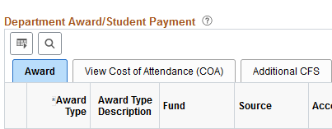
Request a COA Adjustment
Use the View Cost of Attendance (COA) tab to see submitted requests.
Click View COA tab
tester
Notes:
After the attestation is completed, you can view your, as well as any other COA adjustment requests that have been made for the student. Click on the view cost of attendance tab. Next, you will be able to see the COA amount(s) requested, which users made the request, and the date it was requested.

Slide 16
Saving The Page
If you have no other awards save the page
Notes:
If there are no other awards to be entered, save the page.

Slide 17
What happens after a COA Adjustment is requested?
COA adjustment requests are automatically sent to the OSSA for review and processing.
OSSA will confirm within with the GradStar user that the COA adjustment request has been successfully processed (within 2-3 business days).
Notes:
After you have made a COA adjustment request in grad star, the request will automatically be sent to the office of scholarships and student aid for review and processing.
The Office of Scholarships and Student Aid will follow up with the grad star user via email after the request has been successfully processed .

Slide 18
Success
Stay tuned for more helpful trainings.
Notes:
Congratulations! You now know how to make a cost of attendance adjustment request in grad star.

